Slide 1
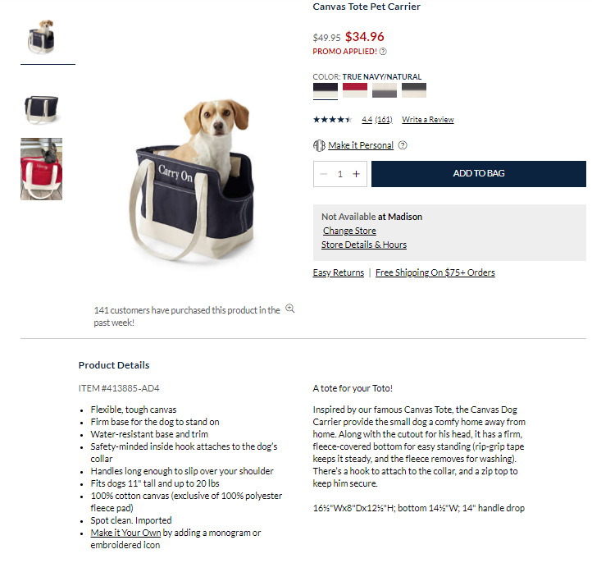
Pet Products Product Page Example
Image
Aspect Ratio: 2x3 (Rectangle top to bottom)
Pixel Depth: At least 2000x3000 pixels
Small Swatches (needed for EACH colorway)
Specs: 70 px x 20 px
Large Swatches (needed for EACH colorway)
Specs: 500 px x 750 px
Image Gallery
Copy Sub Heading, Optional.
Copy: Feature Bullets
Copy: Paragraph Overview of Product

Slide 2
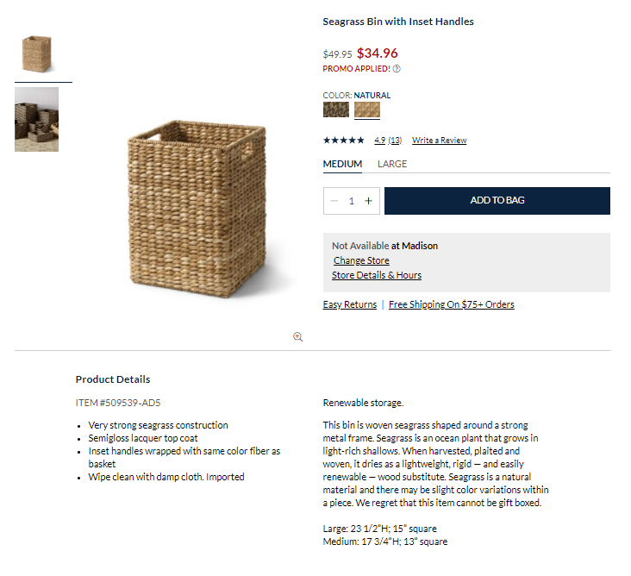
Storage Products Product Page Example
Image
Aspect Ratio: 2x3 (Rectangle top to bottom)
Pixel Depth: At least 2000x3000 pixels
Image Gallery
Small Swatches (needed for EACH colorway)
Specs: 70 px x 20 px
Large Swatches (needed for EACH colorway)
Specs: 500 px x 750 px
Copy Sub Heading, Optional.
Copy: Feature Bullets
Copy: Paragraph Overview of Product

Slide 3
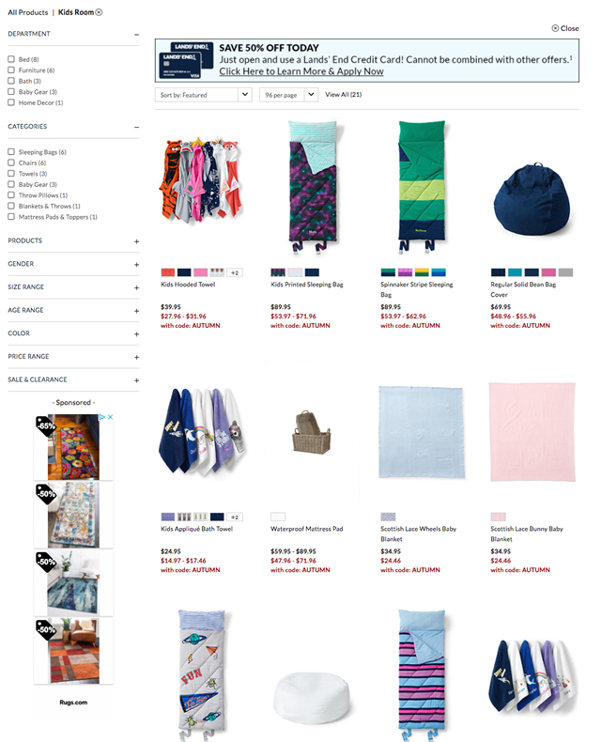
Example of too much white space

